Slide 1

Weekly Report: Week 1
GSP Team B

Slide 2

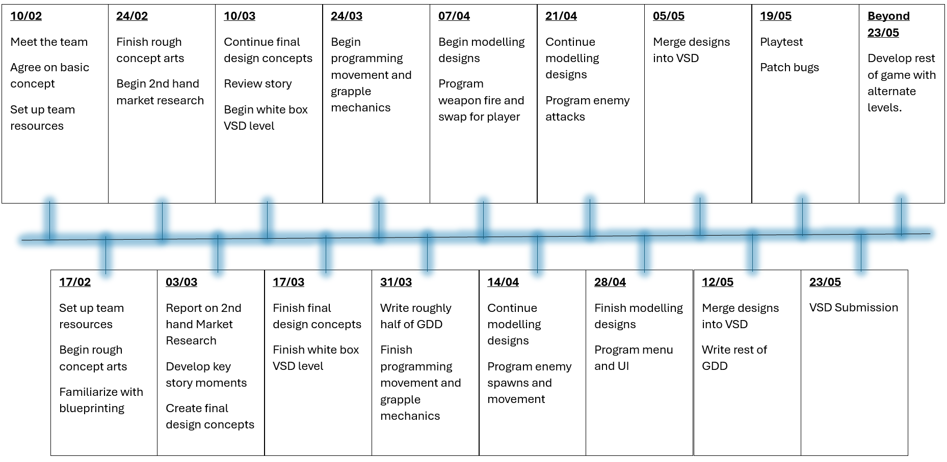
Progress

Slide 3

Team Member Presentations
At this point each team member will present what they have been doing over the past week.

Slide 4
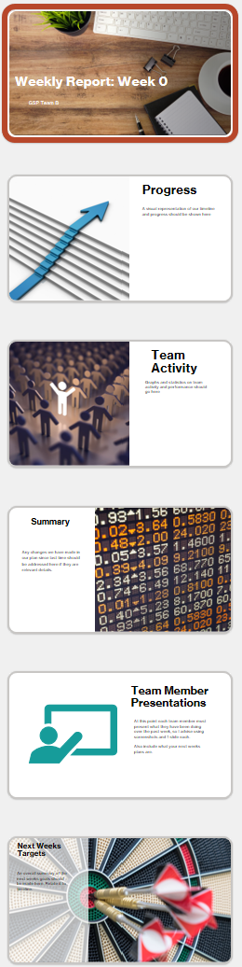
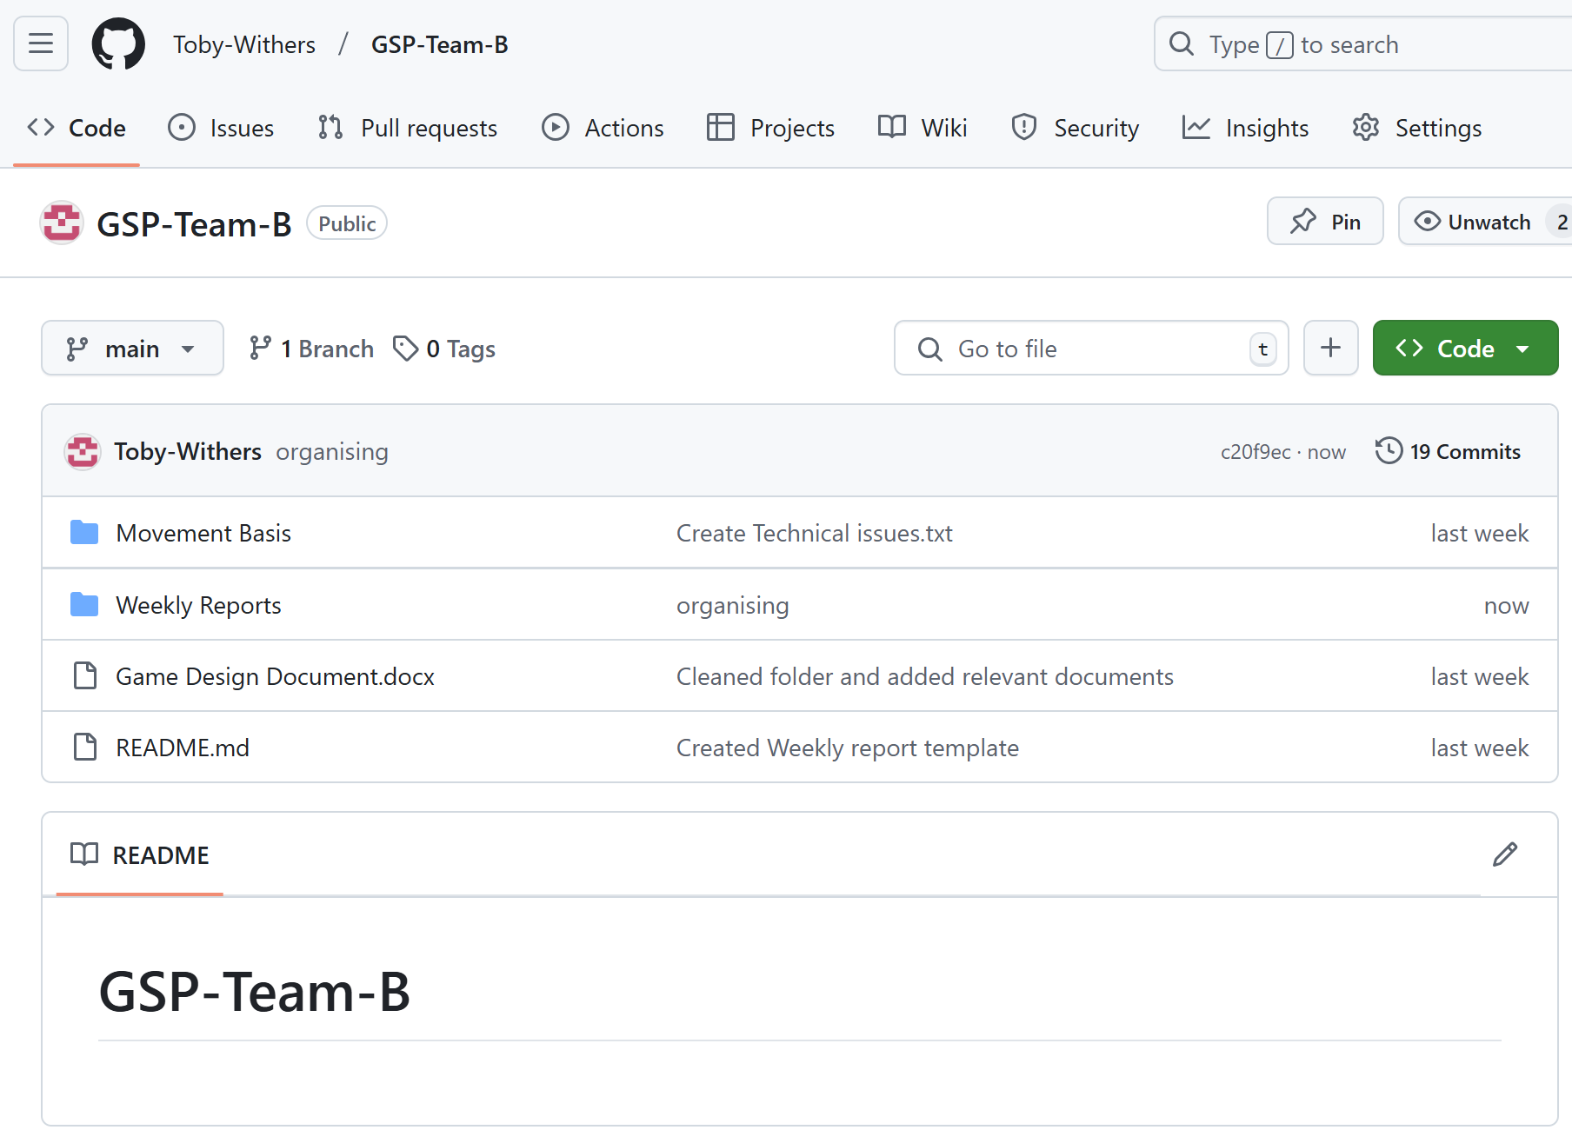
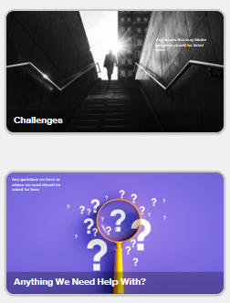
Toby
Github set up
Weekly Report Templating
Laying Out GDD
Creating project plan/timeline
Writing week 1 report

Slide 5
Samuel
Creating rough level concept designs with Blaine

Slide 6
Blaine
Creating rough level concept designs with Samuel

Slide 7
Josh
Creating rough concept art for UI

Slide 8
Bronwyn
Creating rough concept art for weapons

Slide 9
Bailey
Creating rough concept art for enemies

Slide 10
Dan
Revising blueprint methods and researching grapple mechanics

Slide 11
Owen
Revising blueprint methods and researching grapple mechanics

Slide 12
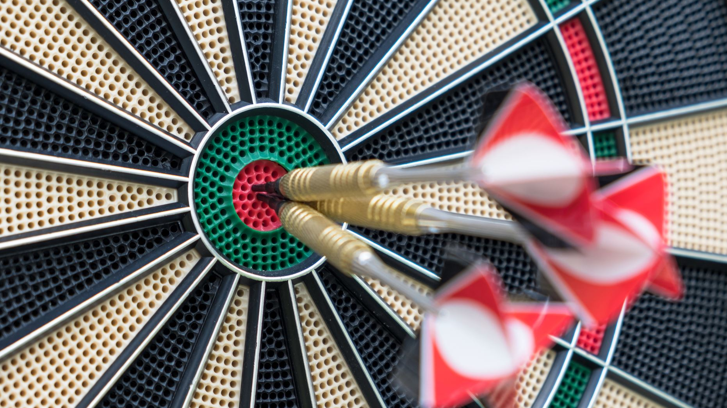
Next Weeks Targets
Toby- Find and analyse market studies.
Sam- Finish rough level concept.
Blaine- Finish rough level concept.
Josh- Help concept enemies.
Bronwyn- Finish rough weapon concepts.
Bailey- Continue concepting enemies.
Dan- Find and analyse market studies.
Owen- Find and analyse market studies.

Slide 13
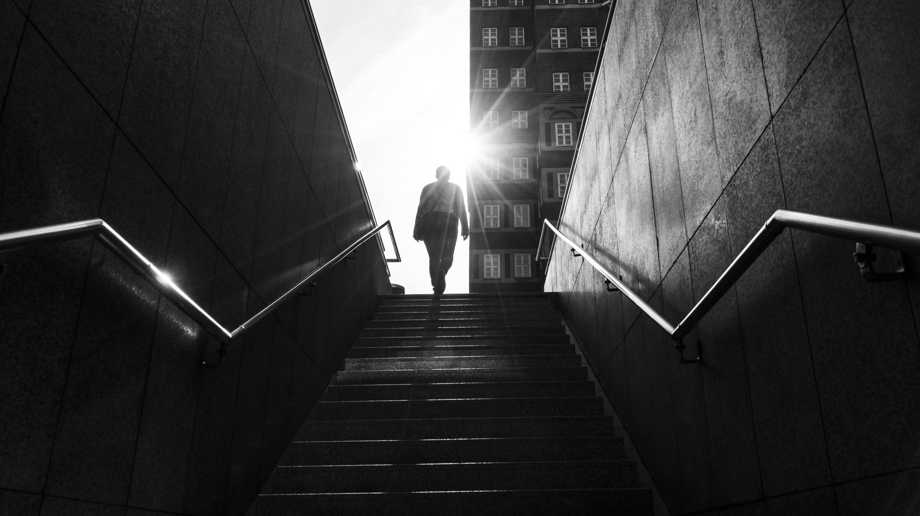
Challenges
Medical issues, illness, familiarity with github, struggles communicating, disengagement, time management with other units.

Slide 14

Anything We Need Help With?
How do we fix conflict errors in github?
How do we push large files to github?

